Slide 1

Introduction into retrieving drug safety data
Retrieving data from the PharmaPendium drug safety data module
Marnix Wieffer
Senior marketing manager drug safety
Notes:
Hello everybody and welcome to this tutorial video, where I will show you how you can retrieve critical drug safety data with PharmaPendium.

Slide 2
Learning objective
Drug safety module
Content
Taxonomies
Multiparametric search
At the end of this video you should have good understanding how to retrieve drug safety data from PharmaPendium.
This should enable your to quickly uncover critical safety insights, thereby supporting decision making during pharmaceutical development.
Notes:
During this training session we will learn how to work with the drug safety module and discuss content, taxonomies and we do a multiparametric search.
At the end of this video you should have good understanding how to retrieve drug safety data from PharmaPendium.
This should enable your to quickly uncover critical safety insights, thereby supporting decision making during pharmaceutical development.

Slide 3
Example question
I am developing a new drug acting on Cyclin-dependent kinase.
What effects on QT prolongation have been observed in drugs that act on that same target?
Provide insights into the regulatory concerns/feedback you can expect on your drug under development. Helps you to make informed decisions early in the development process.
Provide competitive intelligence. By learning about safety concerns of competing drugs, you can optimize your drug development and positioning.
Notes:
During this trainnig session we work with the following frequently asked example question. Let’s assume we are developing a drug acting on Cyclin-dependent kinase
Now we would like to know: “What effects on QT prolongation have been observed in drugs that act on that same target?”
The answer to this question provides insights into for example: the regulatory concerns/feedback you can expect on your drug under development. Helps you to make informed decisions early in the development process.
It will also Provide competitive intelligence. By learning about safety concerns of competing drugs, you can optimize your drug development and positioning.

Slide 4
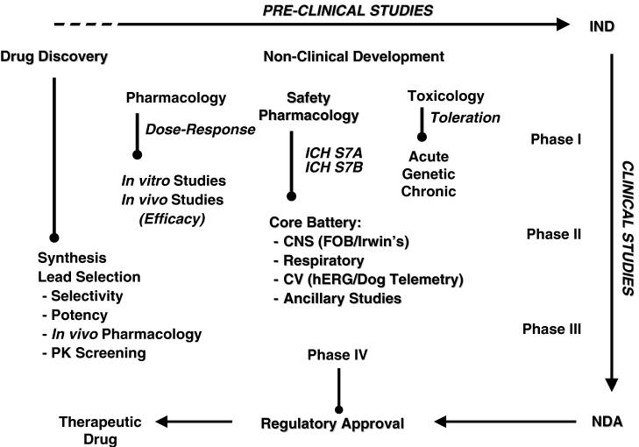
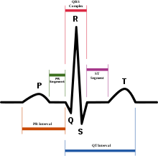
Safety pharmacology – QT prolongation studies
QT interval is a measure of the time between the start of the Q wave and the end of the T wave in the heart's electrical cycle. A lengthened QT interval is a marker for the potential of ventricular tachyarrhythmias like torsades de pointes and a risk factor for sudden death
Since 2005, the FDA and EMA have required that nearly all new molecular entities be evaluated in a Thorough QT (TQT) study to determine a drug’s effect on the QT interval.
Notes:
The QT interval is one of the characteristics of he heart's electrical cycle. QT studies are important as lengthened QT interval is a marker for the potential of ventricular tachyarrhythmias.
Since 2005, the FDA and EMA have required that nearly all new molecular entities be evaluated in a Thorough QT (TQT) study to determine a drug’s effect on the QT interval.
Now let’s dive into PharmaPendium and see how we can address this question.

Slide 5
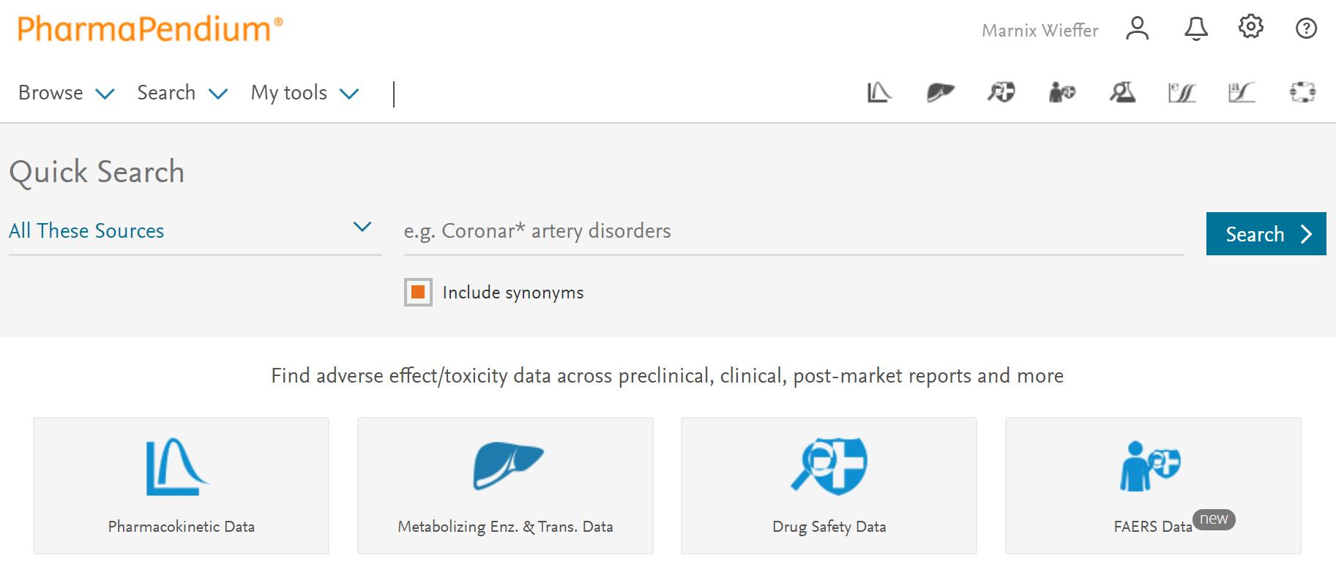
Multiple entry points to start a drug safety search
Browse
Drug safety module
Drug safety module
FDA adverse event data system
Notes:
What I will show you today
\
To start a drug safety search we can use multiple entry points.
For example we could
we could browse for adverse events
Look search the FAERS FDA post-market adverse event database
Or calculate potential DDI risk using the DDI risk calculator
There will be separate tutorial videos on how we can use these entry points
Today we will focus on the drug safety data module that we can access through small icon on the right upperhand corner or the large drug safety data icon
of FDA adverse event data system

Slide 6
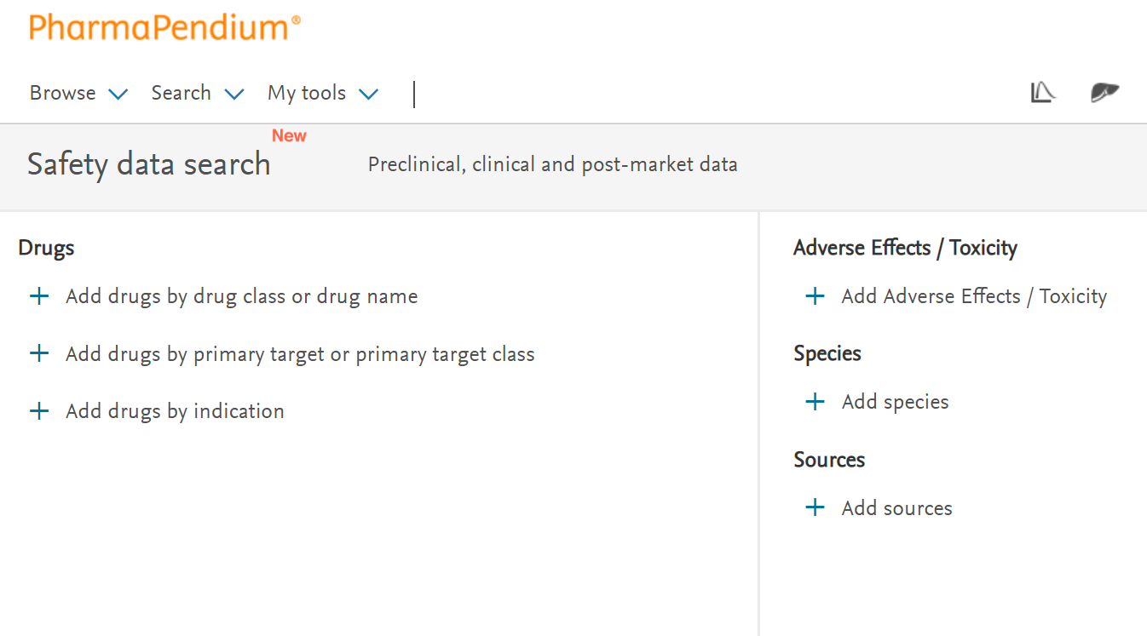
Multiple search limits
Notes:
From the PharmaPendium drug safety search view we can setup a search for safety data using multiple limits. We can limit by drug based on drug class or drug name, primary target or indication.
We can further limit based on adverse effect, species or data sources
Whenever you are doing a search in one of the data modules, it is helpful to take a look at the sources to understand where the data is coming from

Slide 7
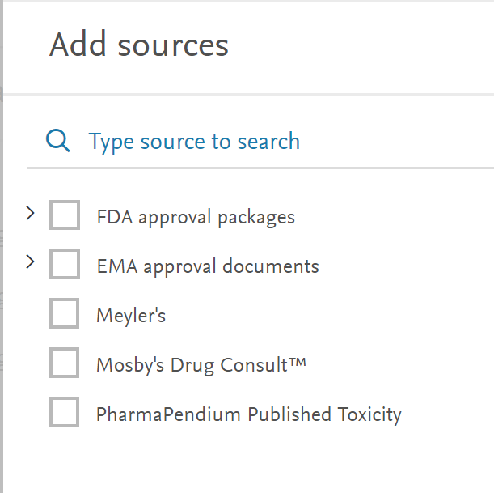
We extract drug safety data from:
Dating back to 1938*
Dating back to 1995
16th edition (Q4, 2019)
Selected literature sources
New extracted data is added to PharmaPendium monthly
Content updates can be found here
*Requires FDA classic collection. Regular FDA coverage start 1992
Notes:
For Pharmapendium we extracts drug safety From 1995-current
What is the update frequency? Every 2 weeks

Slide 8
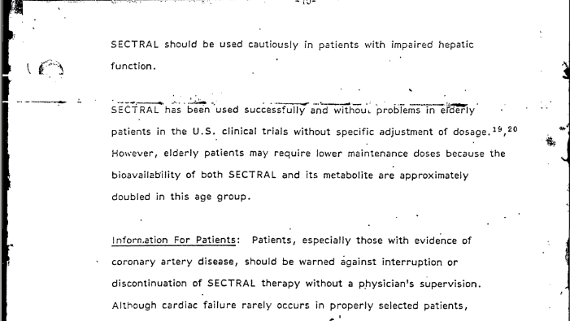
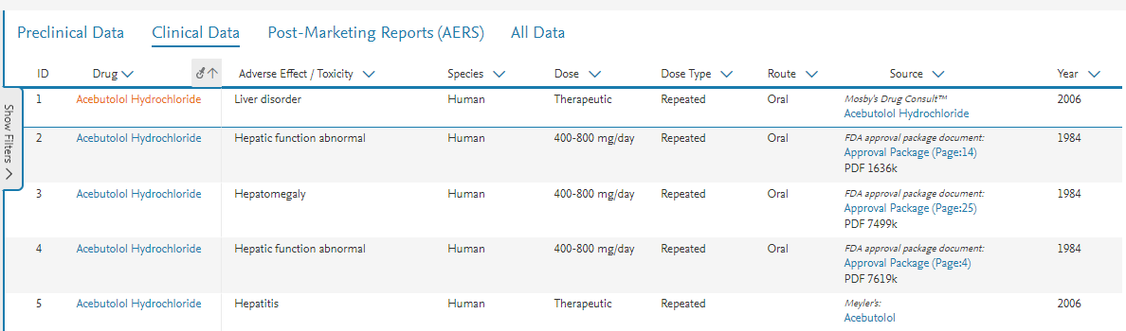

We manually extract data from these sources, ensuring the highest quality data
Unstructured, poorly searchable data
Structured, high quality regulatory safety data that can be easily retrieved from the entire document

Slide 9
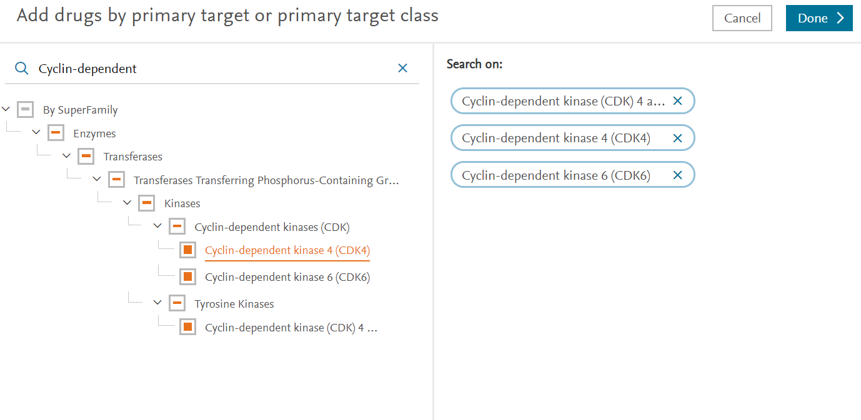
Add drugs based on primary targets
3) Select
1) Type “Cyclin-dependent
2) Select
All drug/target associations are from xPharm®, Mosby's Drug Consult™, FDA Approval Package, EMA EPAR documents.
Targets are indexed using PharmaPendium’s dedicated target taxonomy

Slide 10
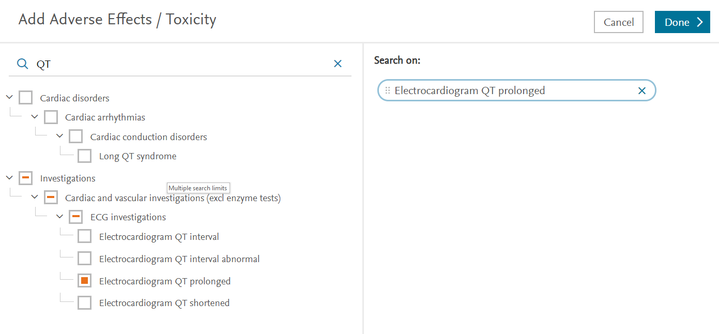
Add adverse effects
3) Select
1) Type “QT” and hit enter
2) Select
PharmaPendium uses MedDRA taxonomy for both preclinical, clinical and post-market data
Delivers insights on how well a preclinical effect translates into the clinic
Notes:
For the adverse effects taxonomy we use the Medra taxnomy and use the terms for both animal studies as well as clinical studies. This allows you to search for adverse effects preclinical and clinical and use the insights to look how well a preclinical effect translates into the clinic. This helps, for example, to determine your drug safety profile and optimize animal model selection
We could either start typing Electrocardiogram. PharmaPendium will autosuggest all term that have the same beginning as the term you are looking for. We could also type another part of the Medra term, for example QT. Although there is no autosuggest, it will recover all terms containing QT and show the location in the adverse event taxonomy. Now we can select the terms of interest “Electrocardiogram QT prolongation”, if you like you can also select higher level terms to broaden your search

Slide 11
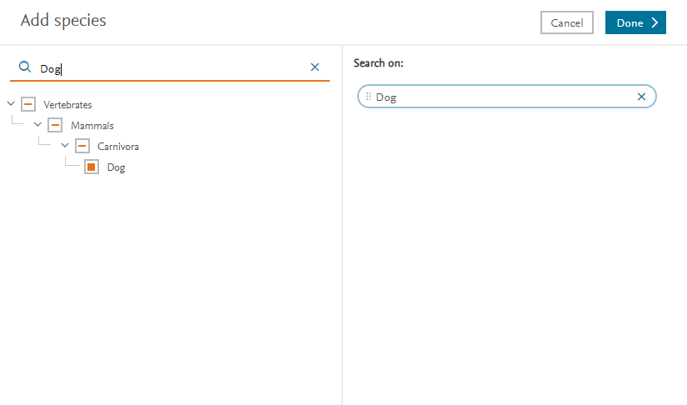
Select species
3) Select
1) Type “dog”
2) Select
Notes:
We get 255 results, for each record we see the context and highlighted in yellow the search terms we were interested in. Next, there is the Drug name, source and the year. So for the second line, the terms “Anti-drug antibody” AND “immunoassay” were found in the approval package for Tocilizumab, that was published in 2013.
FDA advisory committee meeting are generally not linked to a specific drug, therefore there is no drug name in the first result.
255 data lines might be too much to analyze and we could use some help zooming in to the data most relevant for us. First we can sort the data either Ascending or descending. Depending on the content this is either alphabetically or numerically. We can also pin a column to left, for example the column year . Especially if we start working with the data modules where we can have up to 30 columns, this is a convenient option to group the data most important to you together.

Slide 12
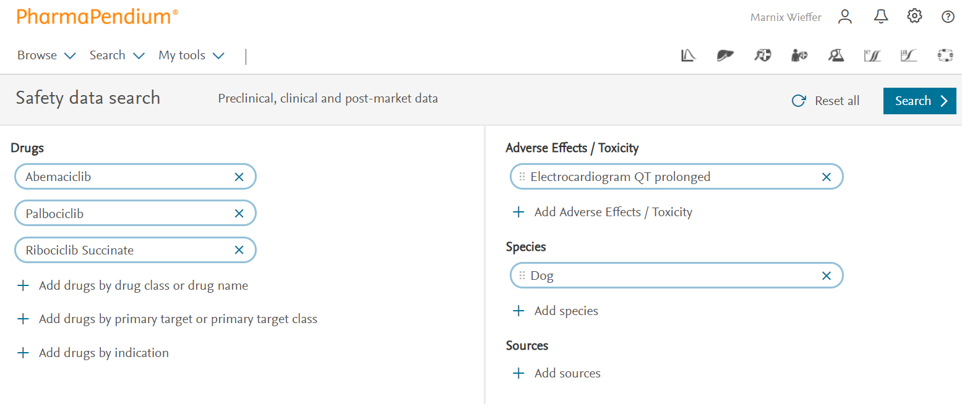
Search over 3 dimensions
search with PharmaPendium’s target, adverse effect and species taxonomy
Notes:
This is our query where we used PharmaPendium’s target, adverse effect and species taxonomy. Please be aware that we can add multiple adverse effects and species working wit Boolean operators. How this works will be explained in a separate tutorial video. Let’s hit search

Slide 13
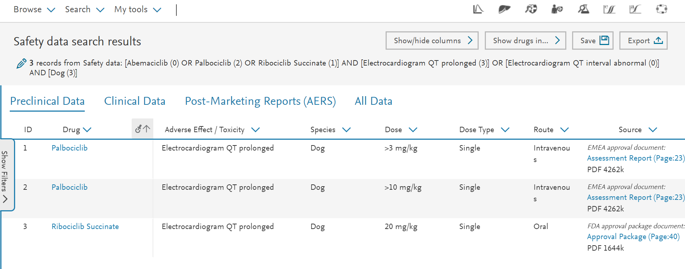
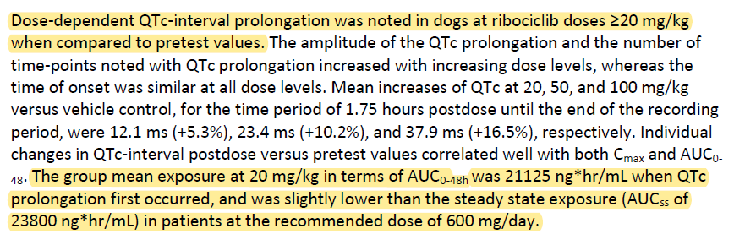
3 results, easy access to the original document
Notes:
What we get are 3 data lines with preclinical adverse event data. As you can see, these are on drug targeting the cyclin-dependent kinase, with the adverse effect QT prolongation in dog. We also find information on the Dose, Dose-type and route of administration.
We can toggle to the clinical and post market data sets. Not surprisingly, these are empty as dog is by definition preclinical.
If you would like to further optimize your search you can go back to your query by clicking on the pen symbol, or manually optimizing your search by clicking query text.
There are many other filtering, sorting and document processing options, these will be explained in separate tutorial
Now, lets dive in to the third document and see what we find.
Indeed, there is a dose depend risk for QT prolongation and that there is a risk that this translates into human.

Slide 14
Notes:
In just a few minutes we exposed the risk for QT prolongation for drugs acting on Cyclin dependent kinases. We have learned from customers that doing this search without PharmaPendium would take weeks, or the data could not be found at all. I hope have provided sufficient information to start using the PharmaPendium drug safety data module. This should enable your to quickly uncover critical safety insights, thereby supporting decision making during pharmaceutical development. I hope you found this video useful, thank you for you attention and good bye

